Slide 1

Gramener Case Study
Credit Risk Analysis

Slide 2

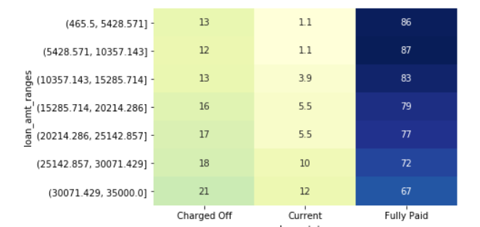
Gramener Case Study
According to data provided following are the insights
When loan amount is more, more charge-offs found

Slide 3
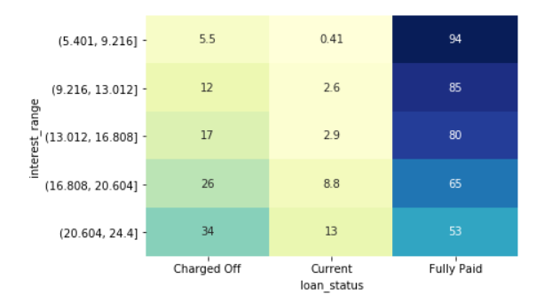
Gramener Credit Risk Analysis
When Interest rate is more, more charge-offs found

Slide 4
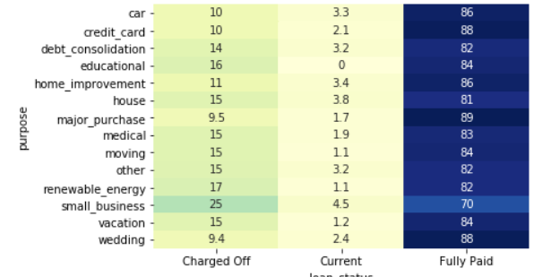
Gamener Credit Risk Analysis
Most of charge off loan purpose is small business

Slide 5
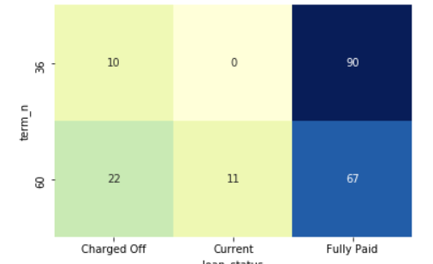
Gamener Credit Risk Analysis
Loan term 60 months noticed that % of charge off is high clearly

Slide 6
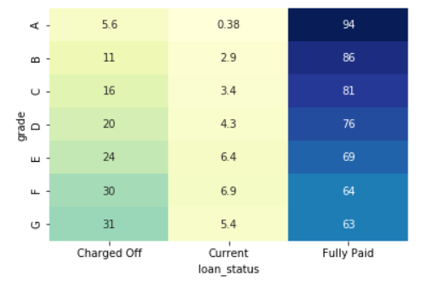
Gramener Credit Risk Analysis
Grade G has highest % of charge off

Slide 7
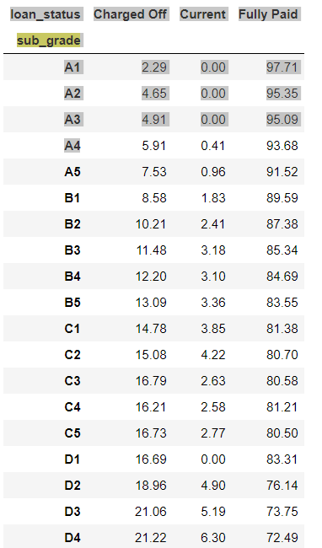
Gramener Credit Risk Analysis
As sub grade increases % of chargeoff increased

Slide 8
Gramener Credit Risk Analysis
Grade G has highest % of charge off

